Slide 1
תזכורת

Slide 2


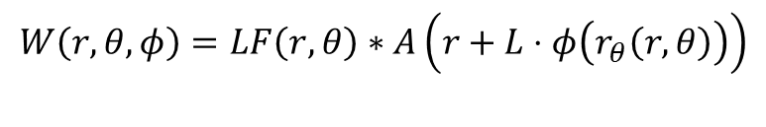
Phase mask(x/y)
$$r_{θ}$$
LF($θ$)
Mask
$$A\left(r+L⋅φ\left(r_{θ}\right)\right)$$
$$W\left(r,θ,φ\right)=LF\left(r,θ\right)∗A\left(r+L⋅φ\left(r_{θ}\left(r,θ\right)\right)\right)$$

Slide 3

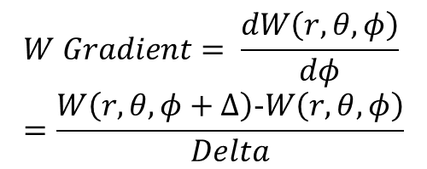
Gradient Descent
Phase mask Gradient(x/y)
$$W Gradient= \frac{dW\left(r,θ,φ\right)}{dφ}=\frac{W\left(r,θ,φ+Δ\right)\text{-}W\left(r,θ,φ\right)}{Delta}$$
$$r_{θ}$$

Slide 4

Line Search (Walker)
Phase mask Gradient(x/y)
$$Δ=arg\max_{Δ∈Δ_{i}}{W\left(r,θ,φ+Δ\right)}$$
$$r_{θ}$$

Slide 5
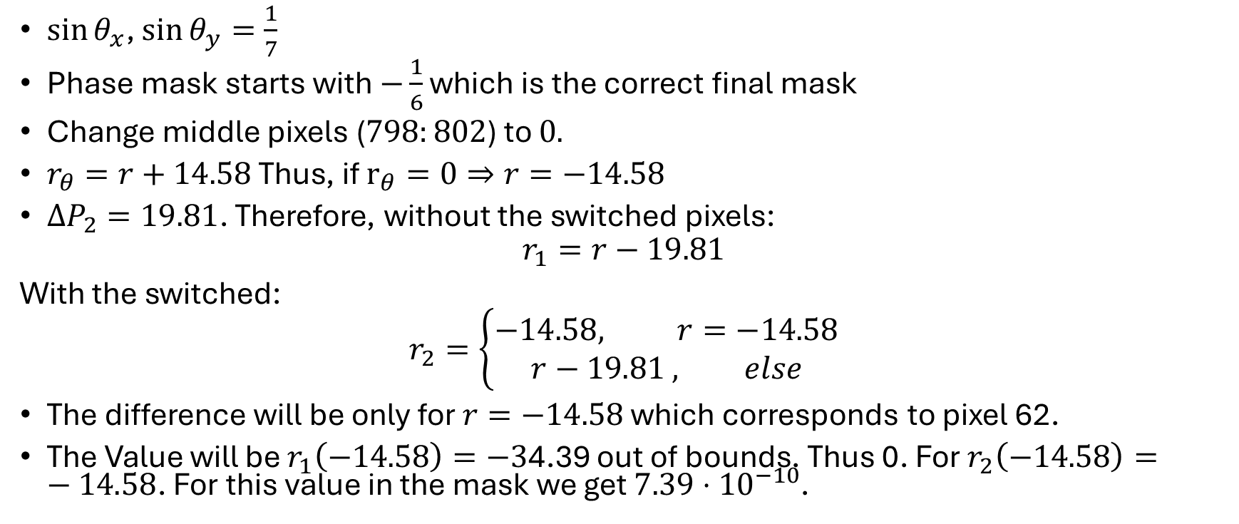
Case test
$\sin{θ_{x}}$, $\sin{θ_{y}=\frac{1}{7}}$
Phase mask starts with $−\frac{1}{6}$ which is the correct final mask
Change middle pixels ($798:802$) to $0.$
$r_{θ}=r+14.58$ Thus, if $r_{θ}=0⇒r=−14.58$
$ΔP_{2}=19.81$. Therefore, without the switched pixels:
$$r_{1}=r−19.81$$
With the switched:
$$r_{2}=\left\{\begin{aligned}−14.58, r=−14.58 \\ r−19.81 , else\end{aligned}\right.$$
The difference will be only for $r=−14.58$ which corresponds to pixel 62.
The Value will be $r_{1}\left(−14.58\right)=−3$4.39 out of bounds. Thus 0. For $r_{2}\left(−14.58\right)=−14.58$. For this value in the mask we get $7.39⋅{10}^{−10}$.

Slide 6
